Slide 1
Section 4.1 Radians and Degrees Measuring Angles in Standard Position
© Copyright all rights reserved to Homework depot: www.BCMath.ca

Slide 2
Review: Trigonometry in PC 11
In PC11, we learnt that trigonometry has to do with using Sine/Cosine/Tangent functions for solving angles in a right triangle
SOH-CAH-TOA
Hypotenuse
Hypotenuse
H
H
Opposite Side
Adjacent Side
Name the sides based on the angle that you are solving for:
O
A
A
Opposite Side
O
Adjacent Side
The “INVERSE” sine/cosine/tangent functions are for finding the angles, when two sides are given.
NOTE: Whenever we are solving for the angles, you usually have TWO answers. USE CAST to determine which quadrants your angles are in

Slide 3
Trigonometry from PC11
This is the CAST rule, used for finding out which quadrants the angles are in based on 1. which Trig Function is used and 2. whether if the ratio is positive or negative
S
A
T
C
Sine function
Cosine function
2. Ratio is positive
2. Ratio is negative
3. Angle is in Q1 Q2
3. Angle is in Q2 Q3

Slide 4
Ex: Solve for $∅$ where $0°≤∅≤360°$

Slide 5
REVIEW) Unit Circles & Rotations
An “unit circle” is a circle rotated around the origin with a radius of 1 unit
The radius starts to rotate from the right side (Initial Arm)
The line rotating around the center is called a “Terminal Arm”
Rotated Counter clock-wise (positive angle)
Rotated Clock-wise (negative angle)
Terminal Arm
Positive Direction
Negative Direction
Initial Arm
© Copyright all rights reserved to Homework depot: www.BCMath.ca

Slide 6

REVIEW) Angles in Standard Position:
When asked to draw an angle in “standard position” begin from the Initial arm (right), ccw – positive, cw - negative
Make sure to draw the ark to show which way the terminal arm(ray) is rotating
Ex: Draw the following angles in standard position: a) 62° b) $−152 °$
in standard position
in standard position
© Copyright all rights reserved to Homework depot: www.BCMath.ca

Slide 7
i) Given that angle “x” is 3000 degrees, which quadrant is it in?
ii) Given that angle “x” is -15500 degrees, which quadrant is it in?

Slide 8

I) Radians vs Degrees: What are Radians?
From this chapter on, angles will be measured in “Radian” instead of “Degrees”
Make sure your calculators are in “RADIAN” mode when using Radians
Radians measure the distance of the arc length,
Definition: “One Radian” is defined as the arc length that is equal to one radii.
“Two Radians” is an arc length that is equal to two radius (diameter)
The arc length of 1 radian is equal to the length of ONE radius
1 Radian
1 Radian
1 Radian
The circumference of a Full circle will have 6.28319 Radians or 2$π$ radians to be exact!!:
0.28319.. ^{R}
??
1 Radian
1 Radian
1 Radian
© Copyright All Rights Reserved. Homework Depot www.BCMath.ca

Slide 9






II) Conversion between Radians & Degrees
Remember: 2$π radians$ is a full circle, so it is equivalent to 360°,
$π radians$ is a half circle, so it is equivalent to 180°
When converting between radians and degrees, use the ratio of $π and 180°$
Angle in radians
$$×$$
$$\frac{180°}{π}$$
Angle in Degrees
Angle in Degrees
$$×$$
$$\frac{π}{180°}$$
Angle in Radians
$$=$$
$$=$$
When writing in radians, try to keep it in terms of $π$ as a fraction if “possible”

Slide 10
Common angles and Radians to Remember:
Since $180°=π$ use fractions of $180°$ to remember these angles in radians:
Use multiples of these angles to get the radian values

Slide 11
Common Angles in Radian Form
© Copyright all rights reserved to Homework depot: www.BCMath.ca

Slide 12
Ex: Convert the following angles from degrees to radians and then draw them in standard position:
i) 315ᴼ ii) 240ᴼ iii) 120ᴼ iv) -77ᴼ vi) 535°
Ex: Convert the following angles from radians to degrees and indicate which quadrant they are in:
i) ii) iii) 6.337^{R} iv) 0.471^{R} v)

Slide 13
in standard position
in standard position
in standard position
in standard position

Slide 14
Ex: Convert the following angles from radians to degrees and indicate which quadrant they are in:
9.42 radians in standard position

Slide 15
VI) Arc Length and Area of a Sector for circles:
The arc length is a fraction of the circumference of the circle
The fraction is given by the central angle divided by the 2π
A sector is the area enclosed by two radii’s
To find the arc length and sector area, use the ratio of the central angle over 360 or 2π, depending on deg or rad

Slide 16
Ex: An arc with a radius of 5m has a central angle of 2.5 radians. Find the arc length.
Practice: An arc with a radius of 7m has a central angle of 177.4°. Find the arc length.
Practice: An arc with a radius of 2.4m has an arc length of 5.3m. Find the central angle in radians and degrees.
Practice: A circle with an area of 100m2 has a sector with an arc length of 13m. What is the area of the sector?

Slide 17
Ex: An arc with a radius of 5m has a central angle of 2.5 radians. Find the arc length.
Practice: An arc with a radius of 7m has a central angle of 177.4°. Find the arc length.
Convert the angle to radians!!
Practice: An arc with a radius of 2.4m has an arc length of 5.3m. Find the central angle in radians and degrees.
© Copyright All Rights Reserved. Homework Depot www.BCMath.ca

Slide 18
VII) Coterminal Angles and Reference Angles
Coterminal angles are angles that are in the same spot in standard position
When given an angle, to find other coterminal angles, plus or minus multiples of 360ᴼ
Suppose angles “A” and “B” are coterminal angles, then:
When writing a general formula for all coterminal angles:
Then add or subtract multiples of 2π or 360ᴼ
Then add or subtract multiples of 2π or 360ᴼ
Start with the smallest positive angle

Slide 19
Ex: Given the following angles, provide two co-terminal angles and a formula for all the co-terminal angles
Add/subtract full circles
to get co-terminal angles
All co-terminal are sums/ differences of 360°
© Copyright all rights reserved to Homework depot: www.BCMath.ca

Slide 20
Practice: Indicate which of the following angles are co-terminal with each other

Slide 21

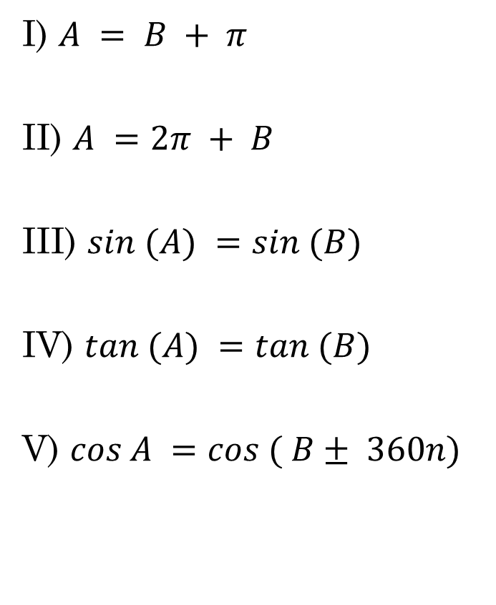
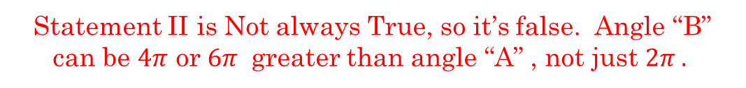
Given that angle ‘A” and “B” are coterminal, indicate which of the following statements are true:
I) $A = B + π$
II) $A =2π + B$
III) $sin (A) =sin (B)$
IV) $tan (A) =tan (B)$
V) $cos A =cos ( B± 360n)$
Statement I is false, b/c the difference between two coterminal angles is a multiple of $2π$ NOT $π$
Statement II is Not always True, so it’s false. Angle “B” can be $4π$ or $6π$ greater than angle “A” , not just $2π .$
Statements III and IV are both true!! If Two angle are coterminal, then the sine/cosine/tangent of each angle will give you the same ratio!!
Statements V is also TRUE

Slide 22
IX) Recognizing Reference angles
Angles with the same height will have the same reference angle
ie: 30°, 150°, 210°, and 330° all have the same reference angle at 30°
ie: 60°, 120°, 240°, and 300° all have the same reference angle at 60°
ie: 45°, 135°, 225°, and 315° all have the same reference angle at 45°
These angles all have the same distance from the X-axis, so their Reference angles are all equal
If we ever encounter these angles, we can use Special triangles
© Copyright all rights reserved to Homework depot: www.BCMath.ca

